Slide 1
Dijkstra’s Algorithm
COP 4530 Final Project Presentation
07.17.2022
Hyunjung Lee
Jonathan James
Geonhee Choi

Slide 2
Introduction
Dijkstra's algorithm is an algorithm for finding the shortest paths from a starting node to a target node in a weighted graph.
It works by building a set of nodes that have a minimum distance from the source and uses a greedy approach to solve the problem and find the best solution.

Slide 3
Overview of Project
We implemented an undirected weighted Graph ADT, with an adjacency list to keep the graph intact and performing Dijkstra’s algorithm to find the shortest path between two vertices.

Slide 4
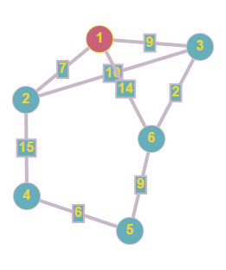
Example
The graph generate the shortest path from node 1 to all the other nodes in the graph.
1. To start, each point’s initial value is set. The starting point is set to 0, and all others are set to infinity. Distance: 1: 0, 2: ∞, 3: ∞, 4: ∞, 5: ∞, 6: ∞
2. Start checking the distance from node 1 to its adjacent nodes (node 2, 3, and 6) and update the distances with the weights of the edges that connect them to node 1. Distance: 1: 0, 2: 7, 3: 9, 4: ∞, 5: ∞, 6: 14

Slide 5
Example
3. Pick the node with the smallest known distance (node2) and move to its neighbors. Update the distances with the weights of the edges that connect to node 2.
4. If the new total distance to a node is less than the previous total, we store the new shorter distance for that node. Continue to finish this process.
Continue the same process until it doesn’t have any unvisited neighbors.

Slide 6
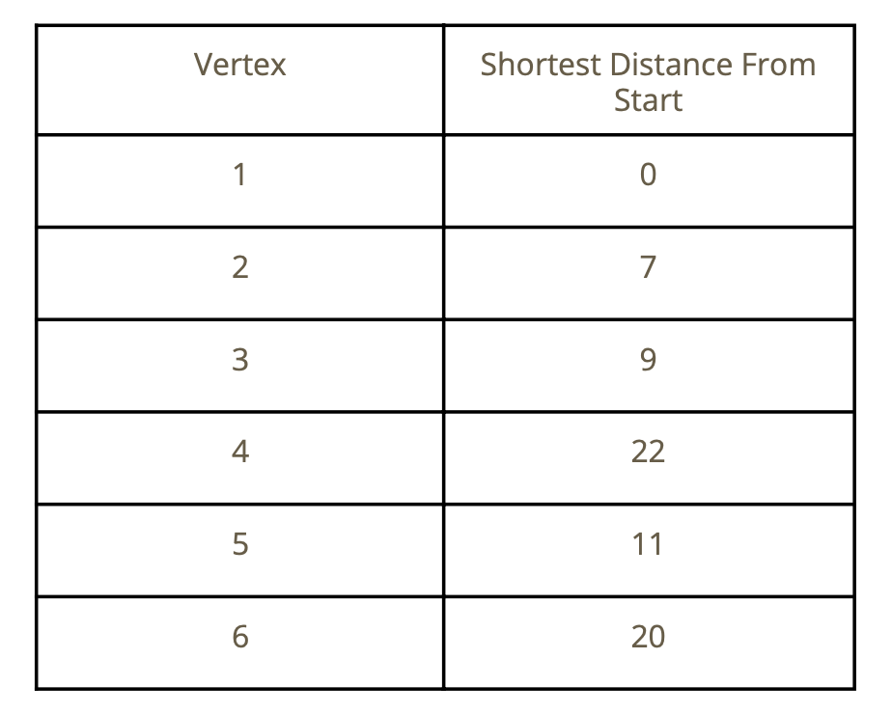
Example
5. Continue the same process until it doesn’t have any unvisited neighbors.

Slide 7
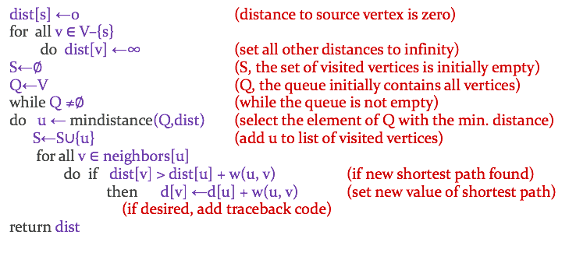
Pseudo-code
This pseudo code shows how to algorithm works

Slide 8
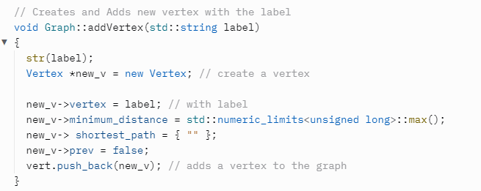
Dijkstra algorithm implementation
In this project, we will have five Abstract Class Methods
1) void addVertex(std::string label)
Creates and adds a vertex to the graph with label. No two vertices should have the same label.

Slide 9
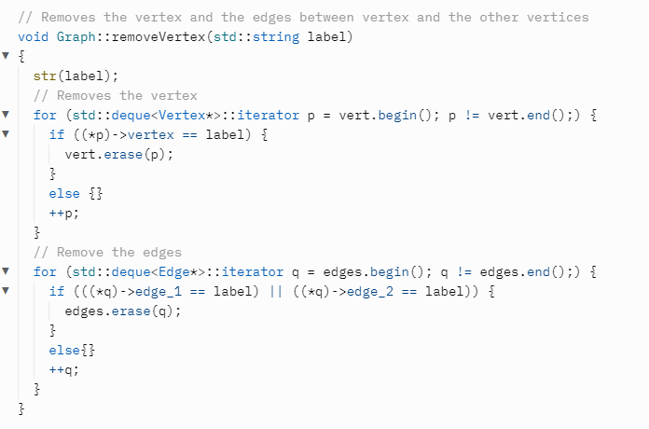
Dijkstra algorithm implementation
2)void removeVertex(std::string label)
Removes the vertex with label from the graph. Also removes the edges between that vertex and the other vertices of the graph.

Slide 10
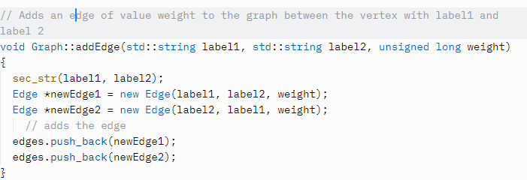
Dijkstra algorithm implementation
3)void addEdge(std::string label1, std::string label2, unsigned long weight)
Adds an edge of value weight to the graph between the vertex with label1 and the vertex with label2.

Slide 11
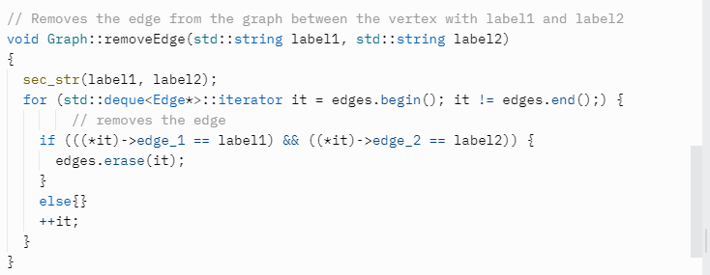
Dijkstra algorithm implementation
4)void removeEdge(std::string label1, std::string label2)
Removes the edge from the graph between the vertex with label1 and the vertex with label2.

Slide 12
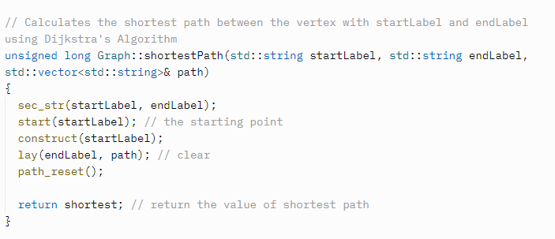
Dijkstra algorithm implementation
5)unsigned long shortestPath(std::string startLabel, std::string endLabel, std::vector &path)
Calculates the shortest path between the vertex with startLabel and the vertex with endLabel using Dijkstra's Algorithm.

Slide 13
Time Complexity
The runtime of this algorithm is O((|E|+|V|) log |V|), where E is the number of edges and V is the number of vertices.

Slide 14
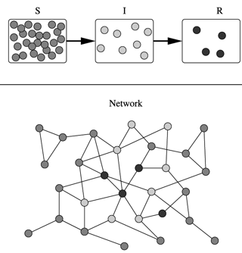
Real World Example
Epidemiology
Networks are used to model the spread of infectious diseases and design prevention and response strategies
The vertices of the graph represent individuals, while the edges represent their possible contacts.
It is useful to calculate how a particular individual is connected to others, and for basically tracing the disease
Calculating and finding the shortest path lengths to other individuals provides the doctors or epidemiologists with the relevant indicator of the potential of a particular individual to infect others.

Slide 15
Conclusion
Dijkstra’s algorithm will help to find the shortest distance between two points in a graph.
This uses the weights of the edges to find the path that minimizes the total distance (weight) between the source node and all other nodes.
This algorithm can handle positive edge weights.
This algorithm is a greedy approach to find the global optimum with the help of local optimum and the appropriate data structure is a priority queue (heap).

Slide 16
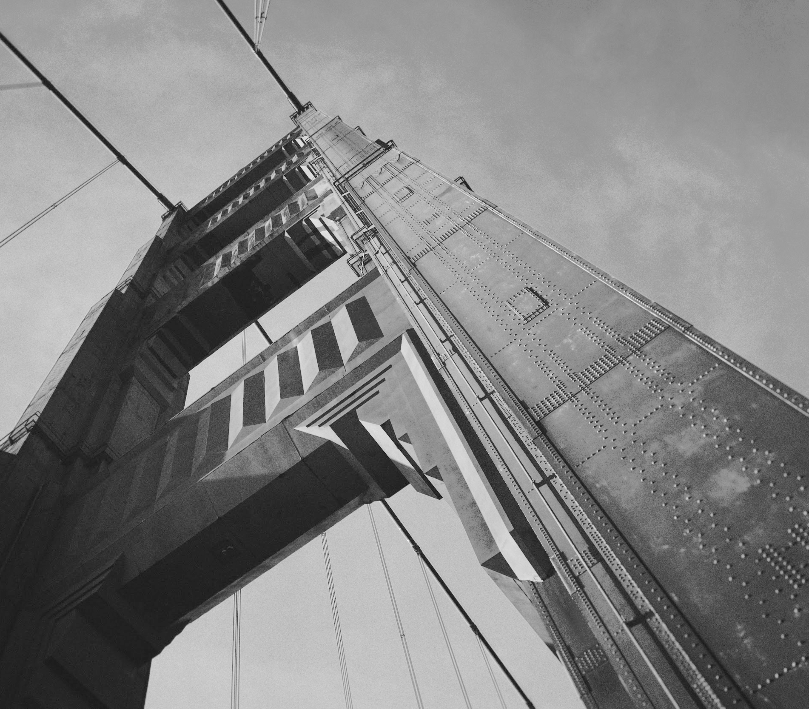
Thanks!

